Slide 1
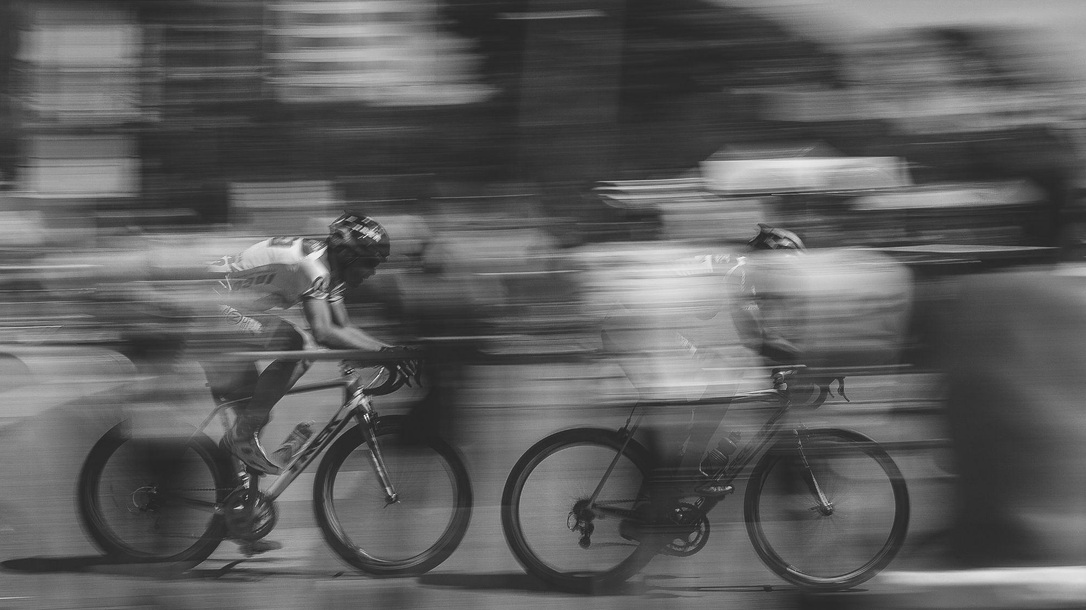
Calibration: Senseable Construction
Calibrate Cityscanner AMS3 & AMS4 to official DCMR data
TNO Project, WP 3.4 (MIT Senseable lab, AMS, WUR)
27-7-2023
Miny Rajiv, Amsterdam and Rotterdam

Slide 2
Calibration steps
Collect data
Have CS AMS3, CS AMS4 next to DCMR (Rotterdam) official stations from: 2023-05-12 to 2023-05-19
Build rectangular dataframe with the four cleaned datasets
Import datasets + get them on the same timeframe
Merge DCMR PM & DCMR NO datasets (local timestamp)
Clean CS datasets + convert to 10-sec intervals
Merge CS datasets (local timestamp)
Merge DCMR and CS + write to csv
Random Forest model

Slide 3
Random Forest model Code
The above is done for*:
NO2, CS3
NO2, CS4
PM25, CS3
PM25, CS4
* Takes about 12 min to run
rf_CS3 <- randomForest(NO2_ppb ~ gas_op2_w_cs3+temperature_opc_cs3+humidity_opc_cs3, data = train_data, ntree=400, importance =TRUE)

Slide 4
RF model results NO2
AMS 3 > print(paste("R-squared CS3:", rf_CS3_2))
"R-squared CS3: 0.931714317354165"
> print(mae_CS3)
[1] 0.9651782
> print(mse_CS3)
[1] 7.076067e-05
> feature_importance_CS3
%IncMSE IncNodePurity
gas_op2_w_cs3 69.85179 1040250.5
temperature_opc_cs3 61.82989 633485.9
humidity_opc_cs3 69.95199 730736.6
AMS 4 > print(paste("R-squared CS4:", rf_CS4_2))
[1] "R-squared CS4: 0.927866178415466"
> print(mae_CS4)
[1] 1.031872
> print(mse_CS4)
[1] 2.275767e-05
> feature_importance_CS4
%IncMSE IncNodePurity
gas_op2_w_cs4 62.39041 820981.7
temperature_opc_cs4 73.08222 720584.6
humidity_opc_cs4 86.85391 842711.1

Slide 5
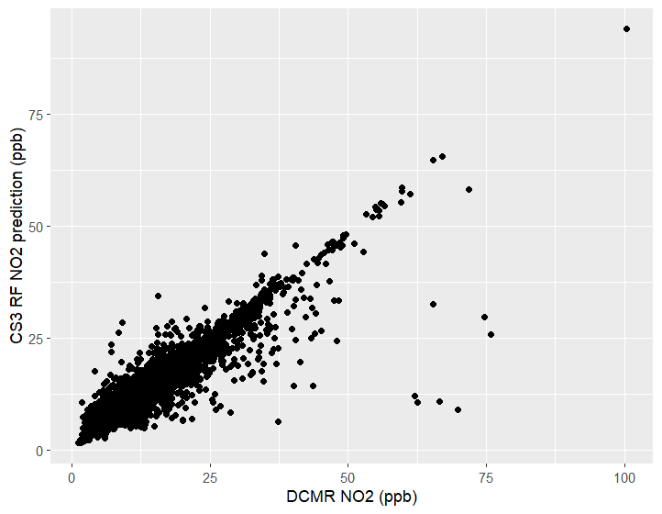
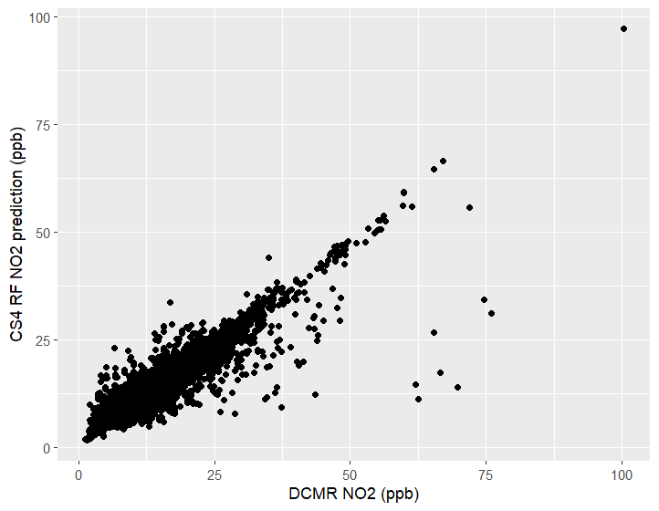
RF NO2, Predicted vs. Actual

Slide 6
If you run the same model, just with the NO2 sensor in the CS and without humidity and temperature:
> print(paste("R-squared CS3:", rf_CS3_2))
[1] "R-squared CS3: 0.421280578853271"
> print(mae_CS3)
[1] 4.011165
> print(mse_CS3)
[1] 0.006419628
> feature_importance_CS3
%IncMSE IncNodePurity
gas_op2_w_cs3 53.67572 1124116
>
> print(paste("R-squared CS4:", rf_CS4_2))
[1] "R-squared CS4: 0.285596165862229"
> print(mae_CS4)
[1] 4.747482
> print(mse_CS4)
[1] 0.01128152
> feature_importance_CS4
%IncMSE IncNodePurity
gas_op2_w_cs4 36.50126 784510.9

Slide 7
RF model results PM25
AMS 3 print(paste("R-squared CS3:", rf_CS3_2))
[1] "R-squared CS3: 0.987341437156443"
> print(mae_CS3)
[1] 5.059842
> print(mse_CS3)
[1] 0.8897286
> feature_importance_CS3
%IncMSE IncNodePurity
PM25_cs3 25.82010 316795.4
temperature_opc_cs3 40.62175 515848.5
humidity_opc_cs3 42.43617 454365.0
>
AMS 4
> print(paste("R-squared CS4:", rf_CS4_2))
[1] "R-squared CS4: 0.986412100433215"
> print(mae_CS4)
[1] 0.3470409
> print(mse_CS4)
[1] 0.0005140808
> feature_importance_CS4
%IncMSE IncNodePurity
PM25_cs4 24.80341 334349.7
temperature_opc_cs4 38.79761 497883.8
humidity_opc_cs4 40.83039 453670.0

Slide 8
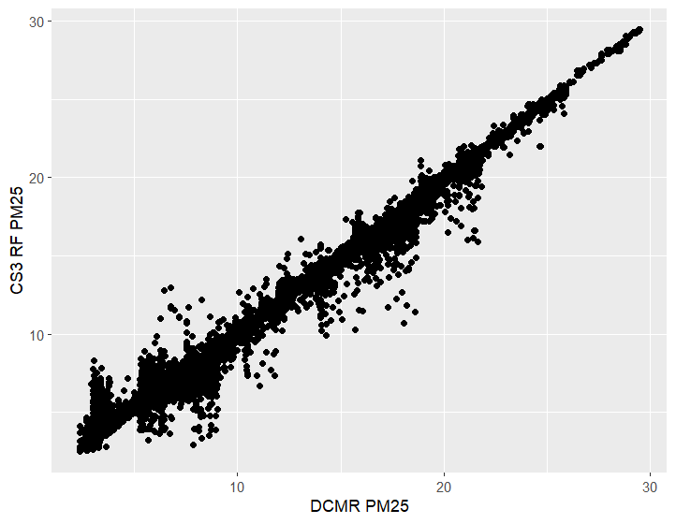
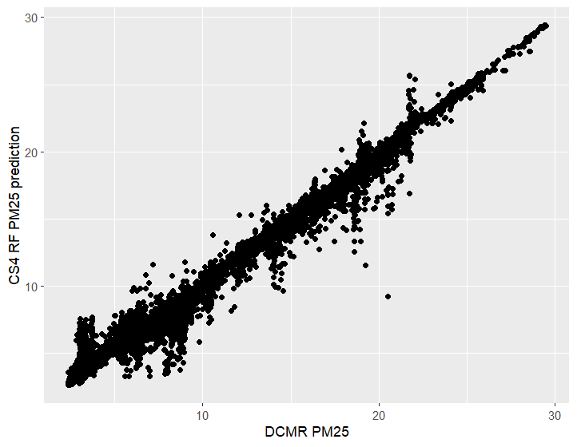
RF PM25, Predicted vs. Actual

Slide 9
If you run the same model, just with the PM25 sensor in the CS and without humidity and temperature:
print(paste("R-squared CS3:", rf_CS3_2))
[1] "R-squared CS3: 0.343396919458529"
> print(mae_CS3)
[1] 3.883997
> print(mse_CS3)
[1] 0.9644515
> feature_importance_CS3
%IncMSE IncNodePurity
PM25_cs3 25.90408 712286.5
>
> print(paste("R-squared CS4:", rf_CS4_2))
[1] "R-squared CS4: 0.395626971487545"
> print(mae_CS4)
[1] 3.53017
> print(mse_CS4)
[1] 0.002005953
> feature_importance_CS4
%IncMSE IncNodePurity
PM25_cs4 27.55941 664439.7

